Slide 1
“Rock”, “Paper”, and “Scissors” Identifier (June 2014)
By: Tan Shuo and Yuxiao Xie
Notes:
Selling you our product – viable solution to this problem you mentioned
Rough breakdown - Problem, solution, future, demo

Slide 2
The Importance of Visual Identifiers
Visual Identifiers
Communication
Security
Games
Notes:
Yuxiao Xie
Visual Identifiers are useful in 3 big areas.
They can be used to ease visual communication in low-light situations, improving identification between similar objects, add another level of security clearance, and be fun in visual games.

Slide 3
The Importance of Visual Identifiers
Our Product
Communication
Security
Games
Notes:
Yuxiao Xie
Our product caters to all 3 areas.

Slide 4
The Importance of Visual Identifiers
Our Product
Communication: Hand Gestures
Security
Games
Notes:
Yuxiao Xie
It can be used in silent communication through hand gesture, as not all situations are talking-appropriate. The algorithm runs fast enough to be used in home front operations as well.

Slide 5
The Importance of Visual Identifiers
Our Product
Communication: Hand Gestures
Security: New Clearance Level
Games
Notes:
Yuxiao Xie
It introduces a security clearance level that does not use traditional input methods.

Slide 6
The Importance of Visual Identifiers
Our Product
Communication: Hand Gestures
Security: New Clearance Level
Games: Rock-Paper-Scissors & Robot Games
Notes:
Yuxiao Xie
Most importantly, it can be implemented in games such as rock-paper-scissors or in robots for robot games.

Slide 7
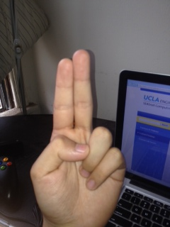

Our Algorithm
Input: 240x320 bmp image
Split into two parts – pre-processing and identification
More consumer friendly
Accommodates noisy backgrounds
Accommodates hand inconsistencies
Notes:
Yuxiao Xie
The preprocessing step increases accuracy of the algorithm.

Slide 8
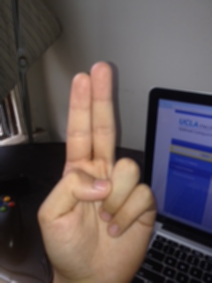
Pre-processing
 | 5 | 5 | 5
 | 5 | 1 | 5
 | 5 | 5 | 5
Median Filter
RGB to YDbDr colorspace
Binary Color Graph
Erode() & Dilate()
bwareaopen()
 | 5 | 5 | 5
 | 5 | 5 | 5
 | 5 | 5 | 5
Original
Blurred
Notes:
Shuo Tan

Slide 9
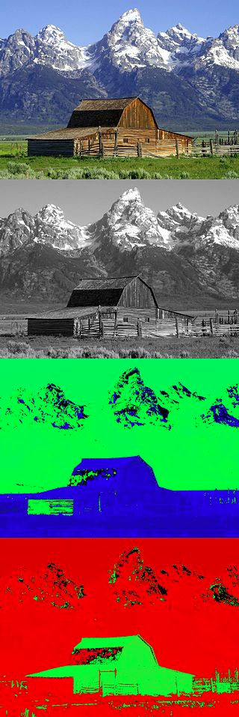
Pre-processing
Y
Median Filter
RGB to YDbDr colorspace
Binary Color Graph
Erode() & Dilate()
bwareaopen()
D_{B}
D_{R}
Notes:
Shuo Tan

Slide 10

Pre-processing
Median Filter
RGB to YDbDr colorspace
Binary Color Graph
Erode() & Dilate()
bwareaopen()
Color to Binary image
Notes:
Shuo Tan

Slide 11
Pre-processing
1 | 1 | 1 | 1 | 1 | 1
1 | 1 | 1 | 1 | 1 | 1
1 | 1 | 0 | 1 | 1 | 1
1 | 1 | 1 | 1 | 1 | 1
1 | 1 | 1 | 1 | 1 | 1
1 | 1 | 1 | 1 | 1 | 1
Median Filter
RGB to YDbDr colorspace
Binary Color Graph
Erode() & Dilate()
bwareaopen()
1 | 1 | 1 | 1 | 1 | 1
1 | 0 | 0 | 0 | 1 | 1
1 | 0 | 0 | 0 | 1 | 1
1 | 0 | 0 | 0 | 1 | 1
1 | 1 | 1 | 1 | 1 | 1
1 | 1 | 1 | 1 | 1 | 1
Notes:
Shuo Tan

Slide 12
Pre-processing
0 | 0 | 0 | 0 | 0 | 0
0 | 0 | 0 | 0 | 0 | 0
0 | 1 | 0 | 0 | 0 | 0
0 | 0 | 0 | 0 | 0 | 0
0 | 0 | 0 | 0 | 1 | 0
0 | 0 | 0 | 0 | 0 | 0
Erode() & Dilate()
0 | 0 | 0 | 0 | 0 | 0
1 | 1 | 1 | 0 | 0 | 0
1 | 1 | 1 | 0 | 0 | 0
1 | 1 | 1 | 1 | 1 | 1
0 | 0 | 0 | 1 | 1 | 1
0 | 0 | 0 | 1 | 1 | 1
Strel Matrix
Notes:
Shuo Tan

Slide 13
Pre-processing
0 | 0 | 0 | 0 | 0 | 0
0 | 1 | 1 | 0 | 0 | 0
0 | 1 | 1 | 0 | 0 | 0
0 | 0 | 0 | 0 | 0 | 0
0 | 0 | 1 | 1 | 1 | 1
0 | 1 | 1 | 1 | 1 | 1
Median Filter
RGB to YDbDr colorspace
Binary Color Graph
Erode() & Dilate()
bwareaopen()
0 | 0 | 0 | 0 | 0 | 0
0 | 3 | 3 | 0 | 0 | 0
0 | 3 | 3 | 0 | 0 | 0
0 | 0 | 0 | 0 | 0 | 0
0 | 0 | 2 | 2 | 2 | 2
0 | 2 | 2 | 2 | 2 | 2
0 | 0 | 0 | 0 | 0 | 0
0 | 0 | 0 | 0 | 0 | 0
0 | 0 | 0 | 0 | 0 | 0
0 | 0 | 0 | 0 | 0 | 0
0 | 0 | 2 | 2 | 2 | 2
0 | 2 | 2 | 2 | 2 | 2
0 | 0 | 0 | 0 | 0 | 0
0 | 0 | 0 | 0 | 0 | 0
0 | 0 | 0 | 0 | 0 | 0
0 | 0 | 0 | 0 | 0 | 0
0 | 0 | 1 | 1 | 1 | 1
0 | 1 | 1 | 1 | 1 | 1
Notes:
Shuo Tan

Slide 14
Pre-processing
After blur and skin color recognition
After erode, dilate, and bwareaopen

Slide 15
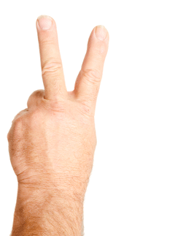
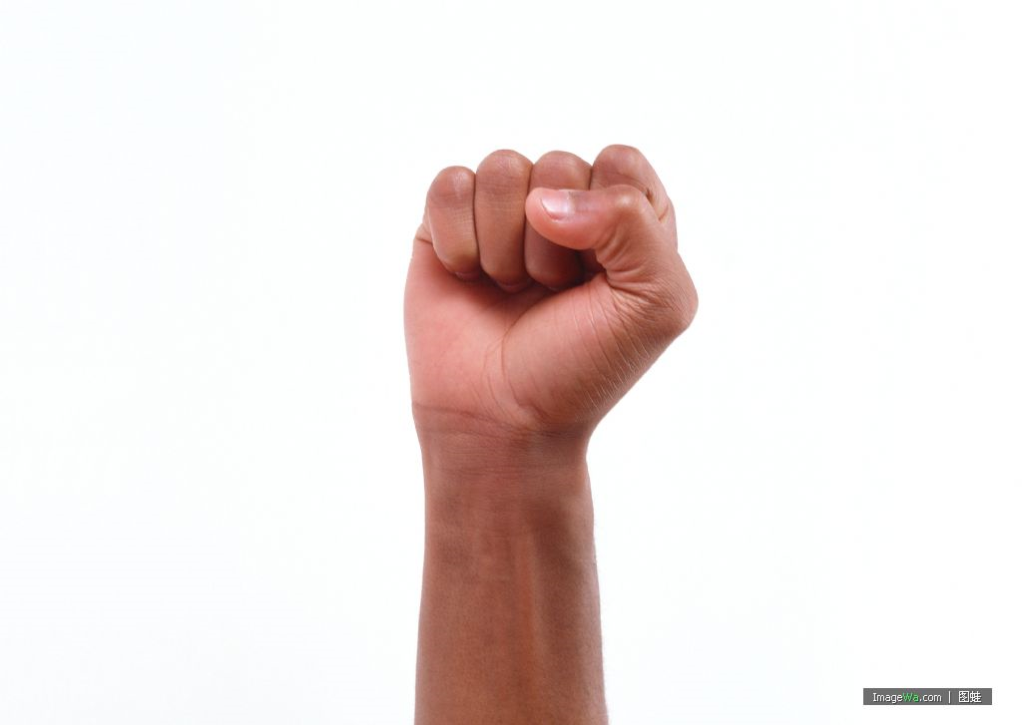
Identification
Largest horizontal width separates top half and bottom half
Top Half
Top Half
Bottom Half
Bottom Half
Notes:
Tan

Slide 16
Identification
Fill = % of top half filled

Slide 17
Identification
Fill = % of top half filled
25% Fill
50% Fill
75% Fill

Slide 18
Identification
Width = widest horizontal part of hand
Length = longest vertical part of hand in top half of hand
Ratio = length
width

Slide 19
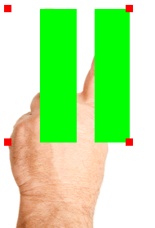
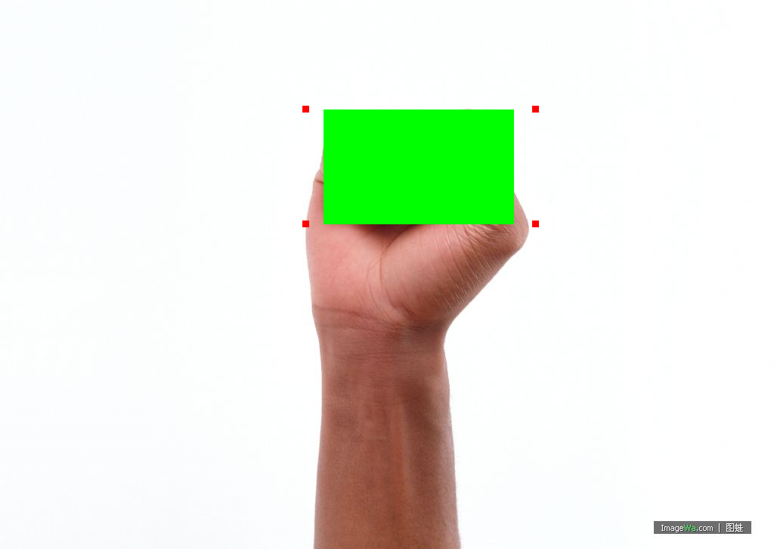
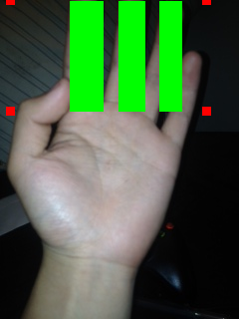
Identification
Segments – Separate blocks when only looking only at the top half

Slide 20
Identification
Find Number of Segments
Segment = 1: Take ratio
Segment = 2: Take ratio
Segment ≥ 3: Take ratio
0.75 ≤ Ratio < 0.9:
Paper
Ratio < 0.5:
Rock
0.5 ≤ Ratio < 0.75: Take fill %
Ratio ≥ 0.9:
Take fill %
Ratio > 0.4:
Scissors
Fill % < 0.6:
Rock
Fill % ≥ 0.6:
Paper
Fill % > 0.55: Paper
Fill % ≤ 0.55: Scissors
Ratio ≤ 0.4:
Rock
Ratio ≤ 0.45:
Rock
Ratio > 0.45:
Paper
Notes:
Tan

Slide 21
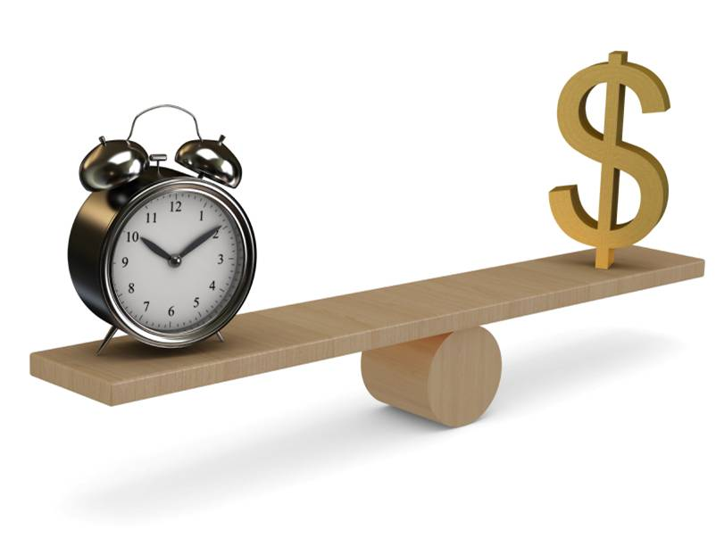
Tradeoffs
Size of picture vs memory
Size of picture vs time
Economic constraints
Basic algorithm with high space and time complexity
Notes:
Yuxiao Xie
We want to find the best tradeoff between economic constraints, time constraints, and quality constraints. In the end we chose the most high space and time complexity yet basic algorithm that can still meet the economic and time constraints, to get the best of all these worlds.
Big O complexity is large – can use faster approximations later

Slide 22
Testing
Many many different pictures showing different situations
Lighting
Background
Hand texture
Hand motion
Results: Flash works the best
Yellow lighting mistaken for hand
Tilt makes hand less identifiable
Notes:
Yuxiao Xie
Many colors and noisy backgrounds with many different aggregates don’t make much of a difference
Different types of hands do not make a difference
Lighting: Bright afternoon sunlight
Even outdoor light
Uneven indoor light (bright spots)
Even indoor light
Yellow background (similar to skin tone)
Background: Bright computer screen
In lab with machines/knobs
Bedroom in background
Colorful background
Hand texture: Nail polish
Hair on hand
Thin female hand
Thick female hand
Male hand
Hand motion: Vertical hand
Slightly tilted hand
Twisted hand, so side of hand is showing
Palm of hand facing camera
Back of hand facing camera

Slide 23
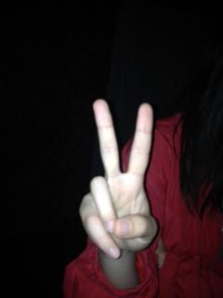

Hand Too White
Notes:
Although it is using flash in a dark room, the hand is now too white.

Slide 24
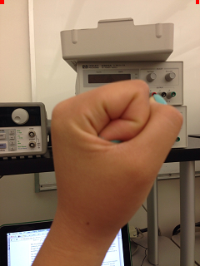
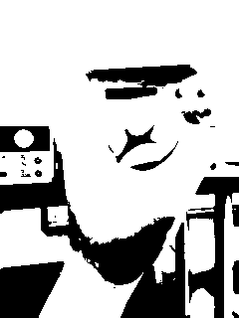
Yellow background
Notes:
Not enough difference between hand color and background color

Slide 25
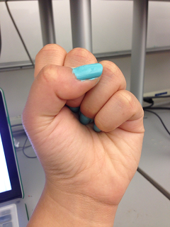
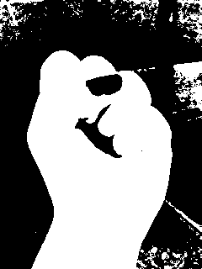

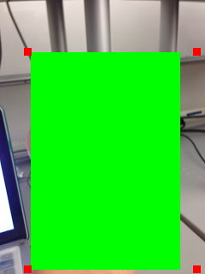
Noisy Background

Slide 26
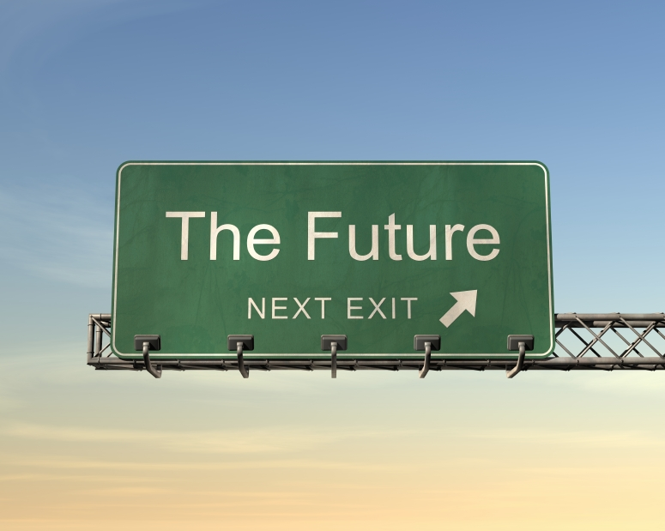
The Future
Turn into real-time identifier with camera
Expand to other hand gestures or other body parts
Try other faster algorithms
New games
Notes:
Yuxiao Xie

Slide 27
Demonstration
Now you can see the product!

